Slide 1
Keweenaw Time Travelers
Group 0b100
February 11th, 2020
Ryan Ader, Kyle Alberth, Rebecca Barkdoll, Christian LaCourt, Daniel Lambert, Evan Monko Mason Sayles, Ruoxi Tian

Slide 2
Scenario 1
(Nominal Task Performance)

Slide 3
Users and Environment
Rachel Alder, Anthropologist
Researches immigrant histories for political policies
Wants to examine the ethnic makeup of the Copper Country through the years, and how this affected the culture and people in the area.

Slide 4
Scenario Description
Finnish___________🔍
Filters [-]
▢ Year [+] ▢ Record Type [-] ▣ Census ▢ School ▢ Employer ▢ Location [+] ▢ Employer [+]
People [+]
Buildings [+]
Addresses [+]
Stories [+]
Records [+]
Types “Finnish” into search bar
Clicks on Filters to expand the menu
Clicks on Records to expand the menu
Selects Census
Hits Enter

Slide 5
Scenario Description
Finnish____________🔍
Filters [+]
People [+]
Buildings [+]
Addresses [+]
Stories (18) [+]
Records (583) [-]
Mary Aho (87) Nick Aho (59) Jack Kiiskila (38) Sigrid Pykkonen (2) See more...
Two categories have results: Records and Stories
Clicking on the categories opens menus with all results
Under Records, Rachel selects “Mary Aho”
A pop-up appears with information on ethnicity, family, occupation, address, and other biographical information

Slide 6
Paper Prototype

Slide 7
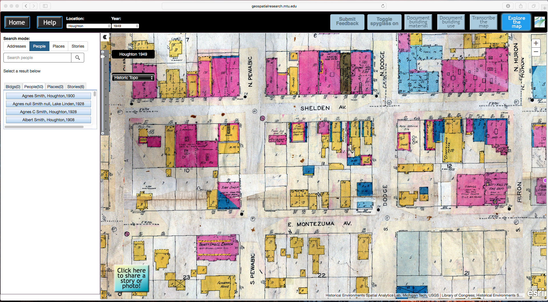
User will type in search phrase here
Filters [+]
People [+]
Buildings [+]
Addresses [+]
Stories [+]
Records [+]
Clicking on Filters will give options. The categories below will not be available until a search is entered.

Slide 8
Smith
Filters [-]
▢ Year [+] ▢ Record Type [-] ▣ Census ▢ School ▢ Employer ▢ Location [+] ▢ Employer [+]
People [+]
Buildings [+]
Addresses [+]
Stories [+]
Records [+]
The Filter categories are multi-select and offer subcategories to choose from as well.

Slide 9
Smith
Filters [+]
People (53) [-]
John Smith (1900) Jane Smith (1917) Joe Smith (1900) Jon Smith (1880) Joel Smith (1880) Jane Smith (1900)
Buildings (7) [+]
Addresses [+]
Stories (18) [-]
Agnes Smith (3) Jon Smith (1) Jane Smith (1)
Records (84) [+]
Once a search has been entered, the categories open up. Numbers by the categories highlight how many results.

Slide 10
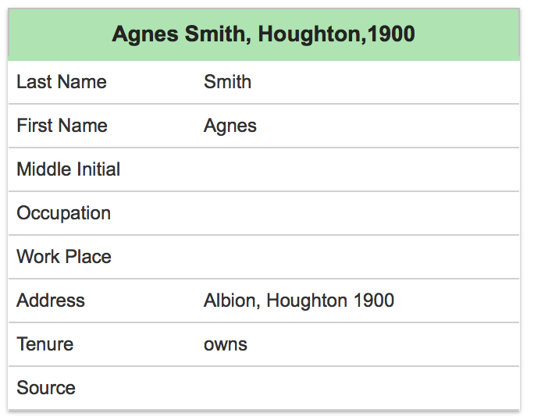
Smith
Filters [+]
People (53) [-]
John Smith (1900) Jane Smith (1917) Joe Smith (1900) Jon Smith (1880) Joel Smith (1880) Jane Smith (1900)
Buildings [+]
Addresses [+]
Stories (18) [-]
Agnes Smith (3) Jon Smith (1) Jane Smith (1)
Records (84) [+]
R
Clicking on a result will bring up an information blurb with links to other information.
Clerk
Frederick’s Dry Goods
Houghton City Directory 1900
Family (6)
+
Classmates (24)
+
Coworkers (3)
+
Stories About (1)
+
Others Dwelling in Same Building (4)
+
Where Did They Go?
Track Agnes Smith’s movements across time

Slide 11
Usability Goals
Efficient search bar that is usable with only general terms
Intuitive and easy-to-use interface
Easy-to-add filters to narrow down their search
Search results should give information about the people, places, and events from the Keweenaw history

Slide 12
Usability Concerns
We may not have the exact data the user is looking for, and if the user doesn’t know exactly what to search they may not realize that they won’t be able to find it
Some people may not find the search bar intuitive or self-explanatory as we believe it is
The search taking a long time as it looks through all possible data

Slide 13
Preliminary Instructions and Other Content
Due to lack of available records at the moment, there will be little information added to the pop-up information
The search bar should be relatively self-explanatory
Clicking on the help button should bring up a set of pop-up instructions to explain what isn’t intuitive

Slide 14
Scenario 2
(Error Handling)

Slide 15
Users and Environment
Rachel Alder, Anthropologist
Researches immigrant histories for political policies
Wants to examine the ethnic makeup of the Copper Country through the years, and how this affected the culture and people in the area.

Slide 16
Scenario Description
Rachel spells the name wrong for a certain family she’s looking for
No results appear
A message will pop up saying so, and will prompt for another search word

Slide 17
Paper Prototype

Slide 18
Smiht
If there’s no results listed, no categories will have numbers beside them. A help message will appear with prompts.
Filters [+]
People [+]
Buildings [+]
Addresses [+]
Stories [+]
Records [+]
No Results Found
Sorry! The phrase “Smiht” is not in our database. Double-check the accuracy of the word(s) you typed in. If it’s not correct, please try again.
Otherwise, is there another phrase we can help you find?

Slide 19
Questions?

